Slide 1
Reading with your child in the EYFS

Slide 2
Press the link
https://youtu.be/QVQdsOA1z2g

Slide 3
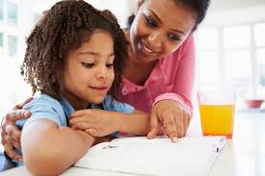
When does a child learn to read?

Slide 4
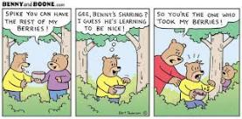
Engagement and Enjoyment
Where do we see print?

Slide 5
What makes a skilled and confident reader?
Talking and listening
Looking and enjoying print and books
Listening for sounds
Learning the letters of the alphabet
Hearing books read aloud

Slide 6
Sounds and words in language
Rhyming
Alliteration
Voice and environmental sounds
Tuning into phonemes
Blending and Segmenting
Phonological awareness

Slide 7
Listening to books read aloud
Self esteem
Positive attitudes/social values
Development of rich vocabulary
Learn learn learn!
Develops listening and attention skills
Make connections between spoken/written words
Children learn the JOY of reading!

Slide 8
Listening to books read aloud
Children learn new words
Develops language development
Boosts self esteem and emotional wellbeing
Supports the children’s writing – develops imagination.
All children in each year group have stories read throughout their time at SMA

Slide 9
Press the link
Mrs Amaan reading aloud
https://youtu.be/CgQUPsmo3S8
Mrs Smith reading aloud
https://youtu.be/6hCcEXOXR-I

Slide 10
How can we support a literacy home environment?
Establish a routine
reading materials
Easy access to books
Paper and writing pencils
Model reading
Chat about the books
Subtitles

Slide 11
Engaging your child
Library or online resource – Oxford Owl
Value books
Let your child choose the book they want to hear
Use funny voices!
Tap into their interests
Take books with you on journeys or shopping trips
Use technology to your advantage

Slide 12
Reading in Nursery
Letters and Sounds, 7 aspects
100 stories challenge
Textless reading books
Reading books with simple words

Slide 13
Reading in Reception
Daily phonics sessions
Children choose their own reading books from a specific set of books
Opportunities to read to an adult; 1:1 and Guided Reading
Extend language and develop comprehension

Slide 14
Reading books
Individual starting points are noted to ensure progression occurs
Comprehension activities are encouraged
Reading books allow children to practice segmenting and then blending.

Slide 15
Watch these two videos of the children being heard read
Press the links
https://youtu.be/5t95lH3QaeE
https://youtu.be/3uGWLxwEKfI

Slide 16
Supporting your child with reading
Use phonics
Play games
Use ‘book talk’
Check understanding
Use question prompts
Model

Slide 17
Supporting your child with reading
Turn off the TV
Read out and about
Play games
Sing songs and rhymes
Tongue twisters
Poetry
TALK TALK TALK!

Slide 18
Feedback
Email any questions
Any areas you would like further support or information?

